Slide 1
Digital Portfolio
STUDENT NAME: PARTHIBAN M
REGISTER NO AND NMID: 222401226/asunm11024ai116
DEPARTMENT: BSC COMPUTER SCIENCE WITH ARTIFICIAL INTELLIGENCE
COLLEGE: DHARMAMURTHUI ROA BHAHADUR CALAVALA CUNNAN CHETTY’S HINDU COLLEGE/MADRAS UNIVERSITY

Slide 2
MY PORTFOLIO

Slide 3


AGENDA
Problem Statement
Project Overview
End Users
Tools and Technologies
Portfolio design and Layout
Features and Functionality
Results and Screenshots
Conclusion
Github Link
3/21/2024 Annual Review

Slide 4

PROBLEM STATEMENT
1.Students often struggle to present their achievements, skills, and projects in a structured digital format.
2.Traditional resumes are static and fail to showcase interactive elements, live projects, and real-time updates.
3.There is a need for a personal digital portfolio that is accessible online, customizable, and visually appealing.

Slide 5

PROJECT OVERVIEW
1.The project is a Digital Portfolio Website developed using HTML, CSS, and JavaScript.
2.It is designed to present personal details, education, skills, projects, and achievements in a modern, responsive, and interactive format.
3.This portfolio acts as a professional online identity for students, useful for placements, internships, and career opportunities.

Slide 6

WHO ARE THE END USERS?
Students – to showcase skills, certificates, and projects.
Recruiters/Employers – to evaluate candidates beyond resumes.
College/Placement Cells – to manage and review student portfolios.
Peers & Network – to collaborate and share professional work.

Slide 7

TOOLS AND TECHNIQUES
From the uploaded files:
Frontend: HTML (structure), CSS (styling), JavaScript (interactivity)
Version Control: GitHub (project hosting & sharing)
Deployment: GitHub Pages / Web Hosting Services
Design Principles: Responsive design, clean UI/UX

Slide 8
POTFOLIO DESIGN AND LAYOUT
Navigation Bar: Home, About, Skills, Projects, Contact
Hero Section: Name, designation, and a brief introduction
About Section: Personal details and career goals
Skills Section: Listed technical and soft skills with progress/visuals
Projects Section: Links to GitHub repositories and live projects
Contact Section: Email, LinkedIn, GitHub links

Slide 9
FEATURES AND FUNCTIONALITY
Interactive Navigation (smooth scrolling & transitions)
Responsive Design (mobile, tablet, desktop friendly)
Linked External Profiles (GitHub, LinkedIn, Email)
Project Showcase with Links
Personal Branding with photo & description

Slide 10
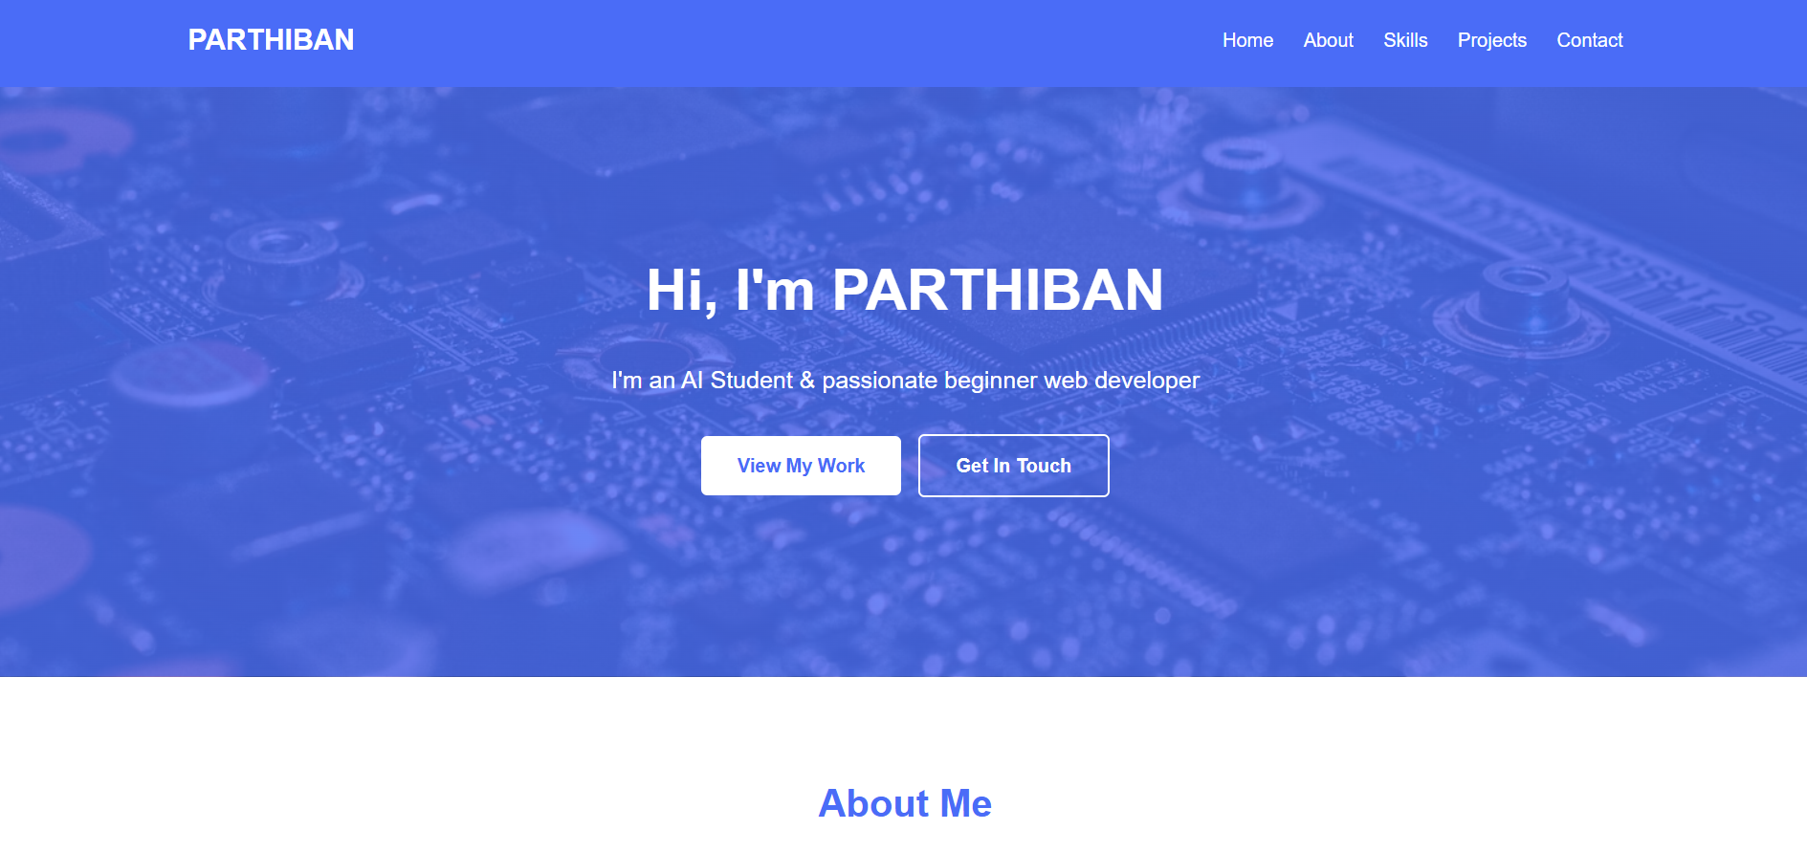

RESULTS AND SCREENSHOTS
3/21/2024 Annual Review

Slide 11
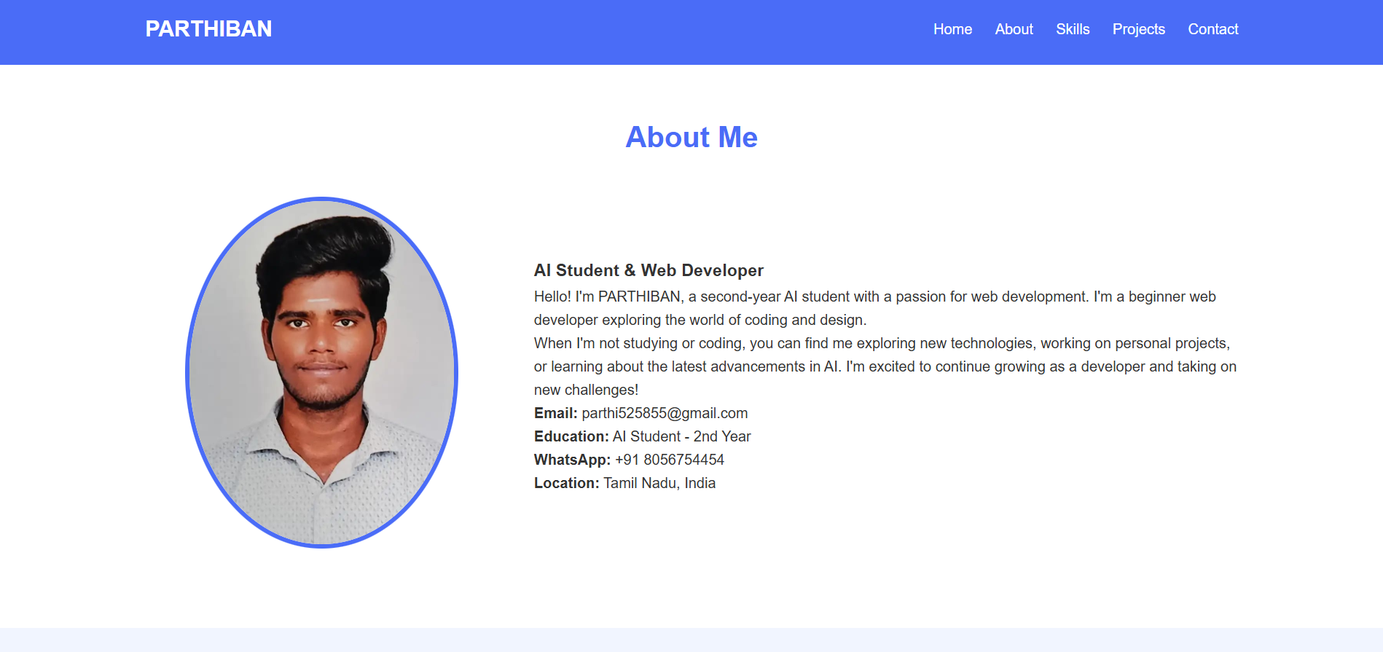
RESULTS AND SCREENSHOTS
3/21/2024 Annual Review

Slide 12
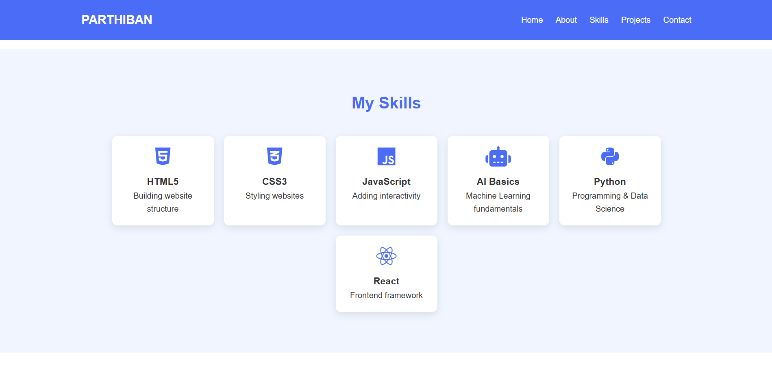
RESULTS AND SCREENSHOTS
3/21/2024 Annual Review

Slide 13
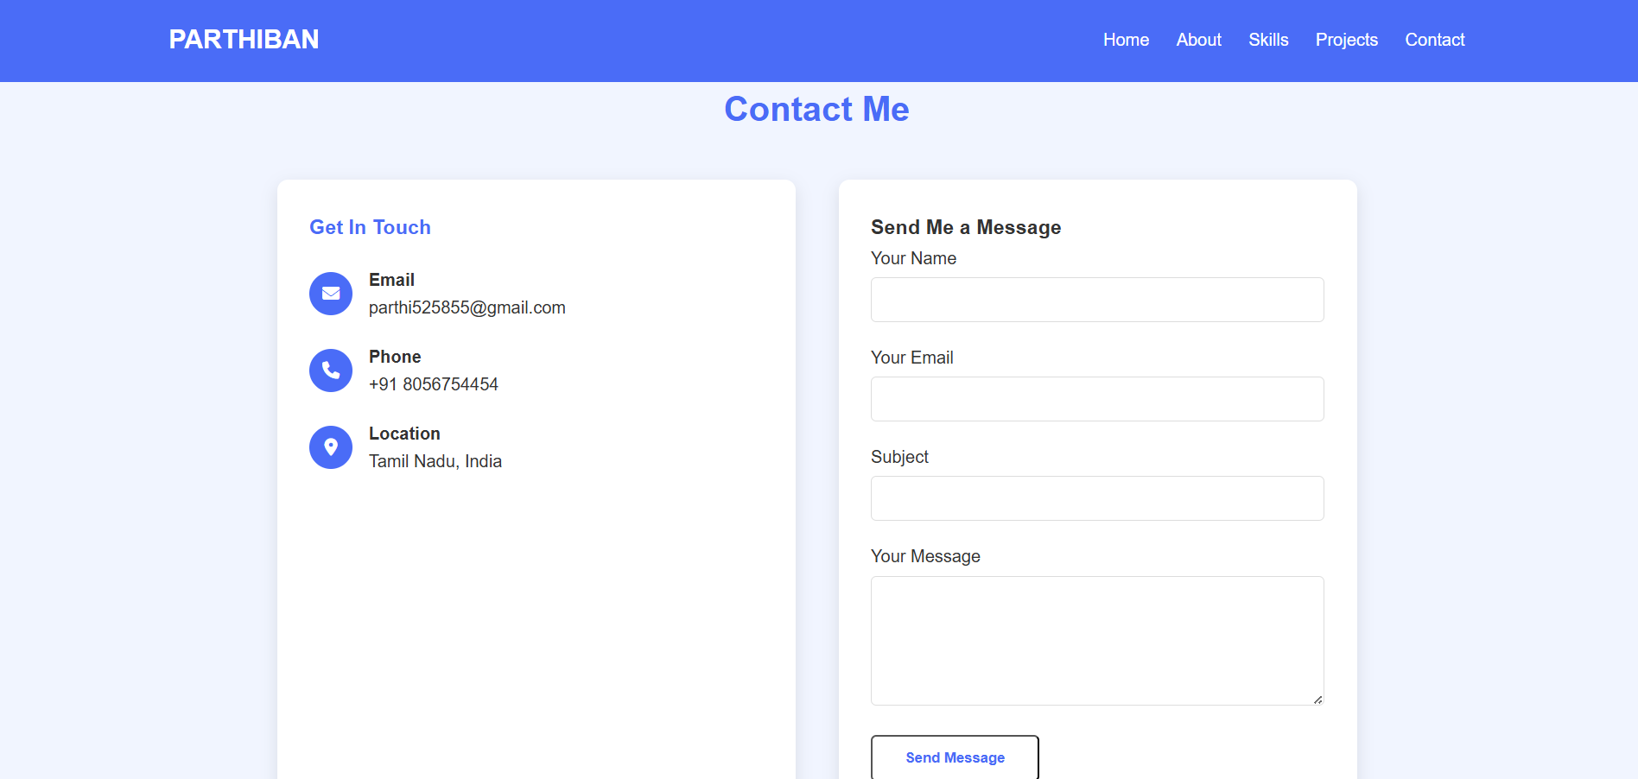
RESULTS AND SCREENSHOTS
3/21/2024 Annual Review

Slide 14
CONCLUSION
The digital portfolio provides a modern and dynamic way of showcasing student achievements.
It bridges the gap between traditional resumes and the growing demand for interactive, online presence.
The project enhances placement opportunities, personal branding, and accessibility for students

Slide 15
GitHub:
🔗 GitHub Repository: parthi525855-oss

